Slide 1
Topic 9 – Similarity, Nearest Neighbors, and Clustering
Data Science for Business
Prof: Chris Volinsky
NYU Stern: Fall 2024

Slide 2
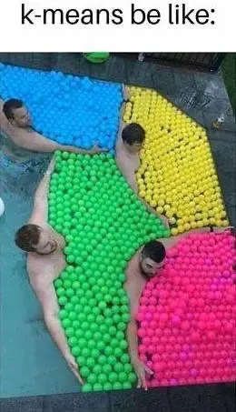
This Chapter
Similarity
How to define similarity through data
K-Nearest Neighbors (kNN)
Using similarities to build a classifier
Clustering
Unsupervised learning using similarities to group data instances
DSB
Chapter 6 - Similarity, Neighbors and Clusters
Shmueli
Chapter 7 – k-Nearest Neighbors
Chapter 15 - Clustering

Slide 3
Similarity

Slide 4

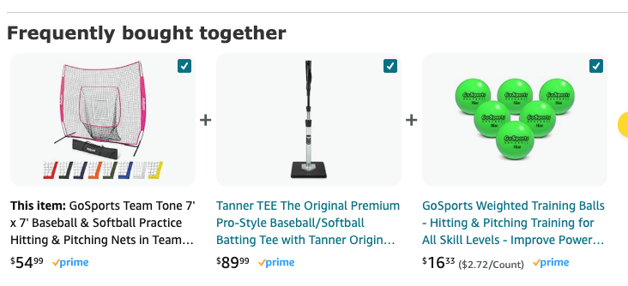
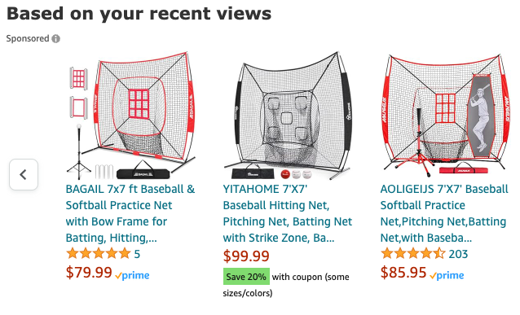
Similarity
The concept of similarity underlies many data science methods and solutions to business problems
Idea: If two things are similar in some ways, they often share other characteristics as well
Think about how similarity is used in retail:
Notes:
Products can be similar
Products can be bought together
People can be similar
How does similarity work in retail?

Slide 5
Similarity and Distance
Similarity can be used for many different data science and business activities
Find similar products to existing products to identify recommendations
E.g. IBM – many products / many clients
recommender systems
DSB whisky example
Identify items/customers who are similar to your known best customers..
What patterns identify our best customers? Find new ones early
Similarity for classification or regression
Use information about similar customers to make predictions about new customers (“nearest neighbors”)
Use similarities to group similar items into clusters
Unsupervised learning

Slide 6





Similarity (and distance…)
Small data set on response to credit card offer…
We need a metric to define how similar any two customers are
Customer | Age | Income | No. credit cards | Response
John | 35 | 35K | 3 | Yes
Charlene | 22 | 50K | 2 | No
Rayshawn | 63 | 200K | 1 | No
Ping | 59 | 170K | 1 | No
Nellie | 25 | 40K | 4 | Yes

Slide 7
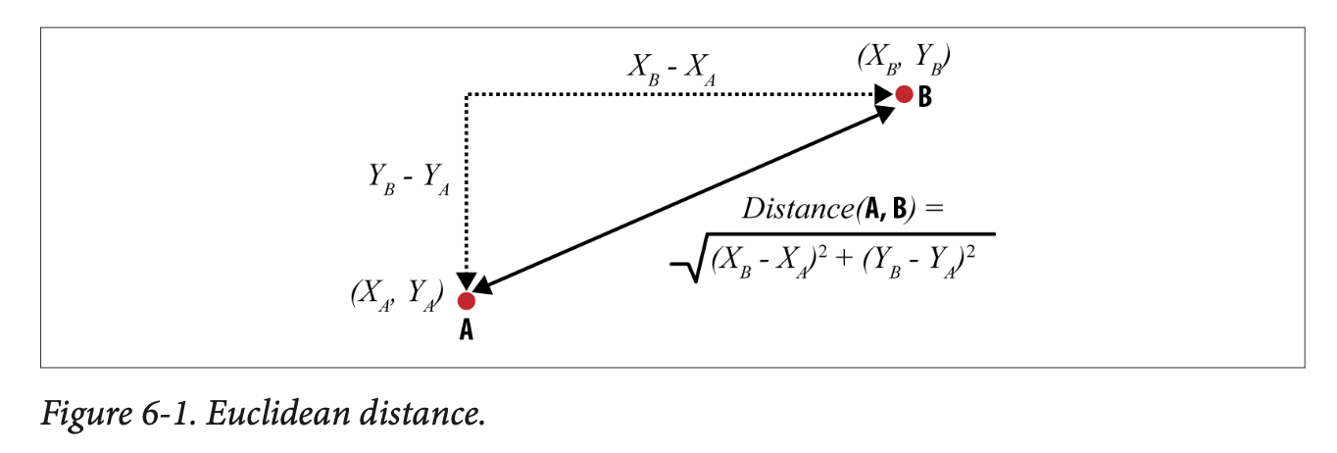
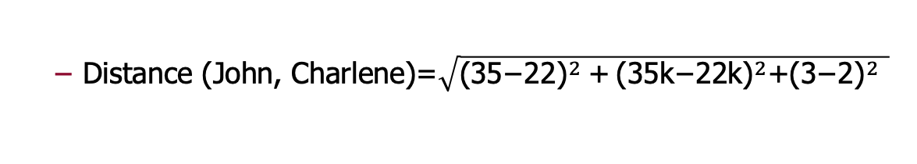
Similarity/distance
Customer | Age (X₁) | Income (X₂) | No. credit cards (X₃) | Response (Y)
John | 35 | 35K | 3 | Yes
Charlene | 22 | 50K | 2 | No
“Closeness” is defined in terms of the distance between two data items.
The most common numeric difference is Euclidean distance:
The Euclidean distance between
X₁=(x₁₁, x₁₂, x₁₃,…x_{1k}) and X₂=(x₂₁, x₂₂, x₂₃,…x_{2k})
Distance (John, Charlene)=$\sqrt{{\text{(35−22)}}^{2} \text{+}{ \text{(35}\text{k}\text{−22}\text{k}\text{)}}^{2}\text{+}{\text{(3−2)}}^{2} }$

Slide 8
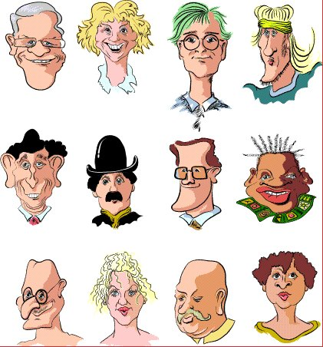
Distances
Sometimes you can make non-numeric data into numeric data, just for the purposes of creating distances …
case | sex | glasses | Moustache | smile | hat
1 | 0 | 1 | 0 | 1 | 0
2 | 1 | 0 | 0 | 1 | 0
3 | 0 | 1 | 0 | 0 | 0
4 | 0 | 0 | 0 | 0 | 0
5 | 0 | 0 | 0 | 1 | 0
6 | 0 | 0 | 1 | 0 | 1
7 | 0 | 1 | 0 | 1 | 0
8 | 0 | 0 | 0 | 1 | 0
9 | 0 | 1 | 1 | 1 | 0
10 | 1 | 0 | 0 | 0 | 0
11 | 0 | 0 | 1 | 0 | 0
12 | 1 | 0 | 0 | 0 | 0
Notes:
Which two are the closest? The furthest?

Slide 9
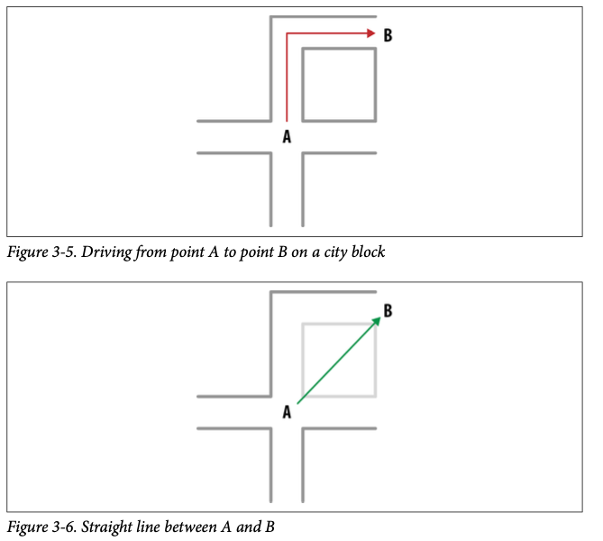
Different types of similarity/distances
Numeric distances
Euclidean
Manhattan
Cosine distance
Binary vectors
P2 = 10010
P6 = 00101
Hamming distance: # of changes to get from A to B
Hamming(P2,P6) = 4
NLP: distance between documents often measured by cosine distance between TF or TFIDF matrices
DSB chapter 6

Slide 10
K-Nearest Neighbors (kNN)

Slide 11
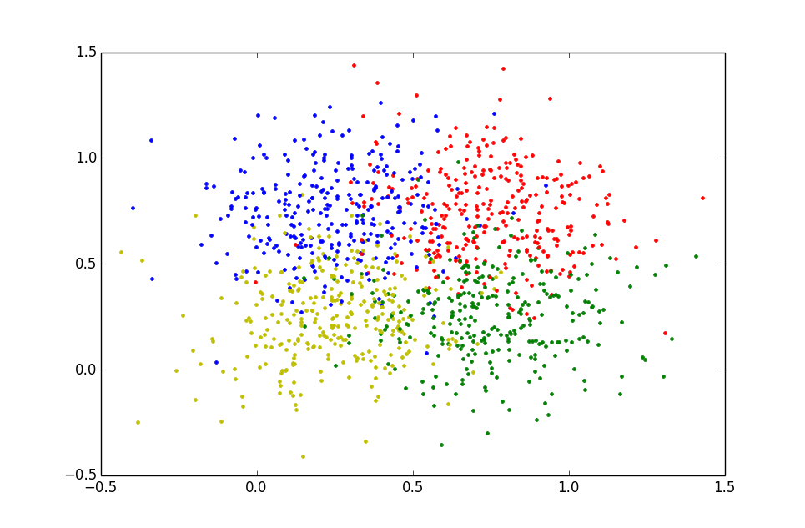
Nearest Neighbors: The idea
K-Nearest Neighbors (kNN) is a classification algorithm that ignores global structure and simply looks at similarities
I don’t know anything about this new customer…but if I can find their “neighbors” I might be able to infer something…

Slide 12

Using similarity for classification
Customer | Age | Income | No. credit cards | Response
John | 35 | 35K | 3 | Yes
Charlene | 22 | 50K | 2 | No
Rayshawn | 63 | 200K | 1 | No
Ping | 59 | 170K | 1 | No
Nellie | 25 | 40K | 4 | Yes
Jalen | 37 | 50K | 2 | ?
Notes:
Concptionslly the idea is easy…who is he most similar to and use that to make a predictions

Slide 13
Nearest Neighbors for Classification
To determine the class of a new example (Jalen):
Calculate the distance between Jalen and all examples in the training set
Select k examples closest to Jalen in the training set
Assign Jalen to the most common class* among its k nearest neighbors
yes
Similarity rank =2
Similarity rank =4
no
Similarity rank =1
yes
Prediction for Jalen = yes
Similarity rank =5
Similarity rank =3

Slide 14
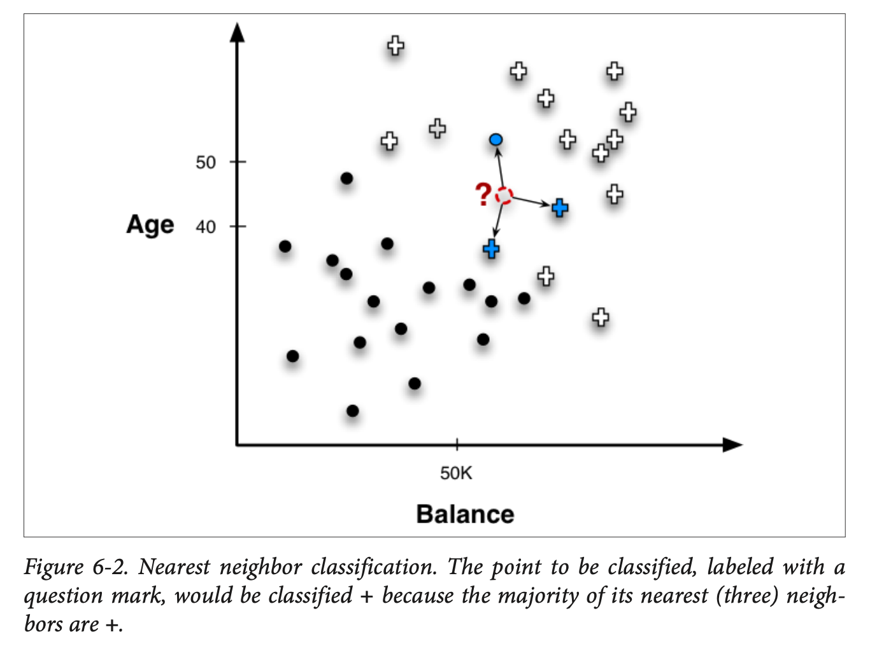
K-nearest neighbors
This is called “k-nearest-neighbors” or kNN classification
Note that your answer will depend on the k that you choose

Slide 15
Example: K=1
Customer | Age | Income (K) | No. cards
John | 35 | 35 | 3
Charlene | 22 | 50 | 2
Rayshawn | 63 | 200 | 1
Ping | 59 | 170 | 1
Nellie | 25 | 40 | 4
Jalen | 37 | 50 | 2
Response
Yes
No
No
No
Yes
?
Distance from Jalen
sqrt [(35-37)²+(35-50)² +(3-2)²]=15.16
sqrt [(22-37)²+(50-50)² +(2-2)²]=15
sqrt [(63-37)²+(200-50)² +(1-2)²]=152.23
sqrt [(59-37)²+(170-50)² +(1-2)²]=122
sqrt [(25-37)²+(40-50)² +(4-2)²]=15.74
NO (1/1)

Slide 16
Example: K=3
Customer | Age | Income (K) | No. cards
John | 35 | 35 | 3
Charlene | 22 | 50 | 2
Rayshawn | 63 | 200 | 1
Ping | 59 | 170 | 1
Nellie | 25 | 40 | 4
Jalen | 37 | 50 | 2
Response
Yes
No
No
No
Yes
?
Distance from Jalen
sqrt [(35-37)²+(35-50)² +(3-2)²]=15.16
sqrt [(22-37)²+(50-50)² +(2-2)²]=15
sqrt [(63-37)²+(200-50)² +(1-2)²]=152.23
sqrt [(59-37)²+(170-50)² +(1-2)²]=122
sqrt [(25-37)²+(40-50)² +(4-2)²]=15.74
Yes (2/3)

Slide 17
Thought questions
What k is optimal?
What if k=N?
What if k=1?
Notes:
K = n you predict the majority class for everybody
K=1 you have a lot of variance…
Which one has the most complexity

Slide 18
Caution using Euclidean Distance
Customer | Age | Income | No. credit cards | Response
John | 35 | 35K | 3 | Yes
Rayshawn | 63 | 200K | 1 | No
Euclidean distance is often the default that is used for distances in software
BUT, they are very sensitive to the scale of the data used
Distance (John, Rayshawn)=sqrt [(35-63)² + (35,000-200,000)² + (3-1)²]
Distance between neighbors will be dominated by attributes with relatively large values
Goal: Each attribute should have the same “weight”
Solution: Normalize numeric variables – two standard ways to do this
Scale data between 0(min) and 1(max)
Create z-scores by subtracting mean and dividing by standard dev
New feature will have mean = 0 and sd =1
Consider log scale for skewed features
from sklearn.preprocessing import MinMaxScaler
from sklearn.preprocessing import StandardScaler
Notes:
And to take logs, for long-tail distributions (in our case, we divided by 1000)

Slide 19
Min-Max Scaling
All features now between 0-1
Have equal “influence”
Customer | Age | Income | No. cards
John | 0.81 | 0.00 | 0.66
Charlene | 0.00 | 0.91 | 0.33
Rayshawn | 1.00 | 1.00 | 0.00
Ping | 0.90 | 0.82 | 0.00
Nellie | 0.73 | 0.03 | 1.00
Jalen | 0.37 | 0.09 | 0.33

Slide 20
kNN strengths/weaknesses
Simple to implement and use
Can be used with multiple-class targets
Interpretable – easy to explain predictions
No model training steps!
easy to ‘update’
Not as computationally efficient as other classification models
Results are dependent on distance function and scaling
Typically, not the ‘best’ model in terms of performance
Probability estimates less useful (precise) than other methods
Choice of k is important and not always obvious
sklearn.neighbors.KNeighborsClassifier

Slide 21
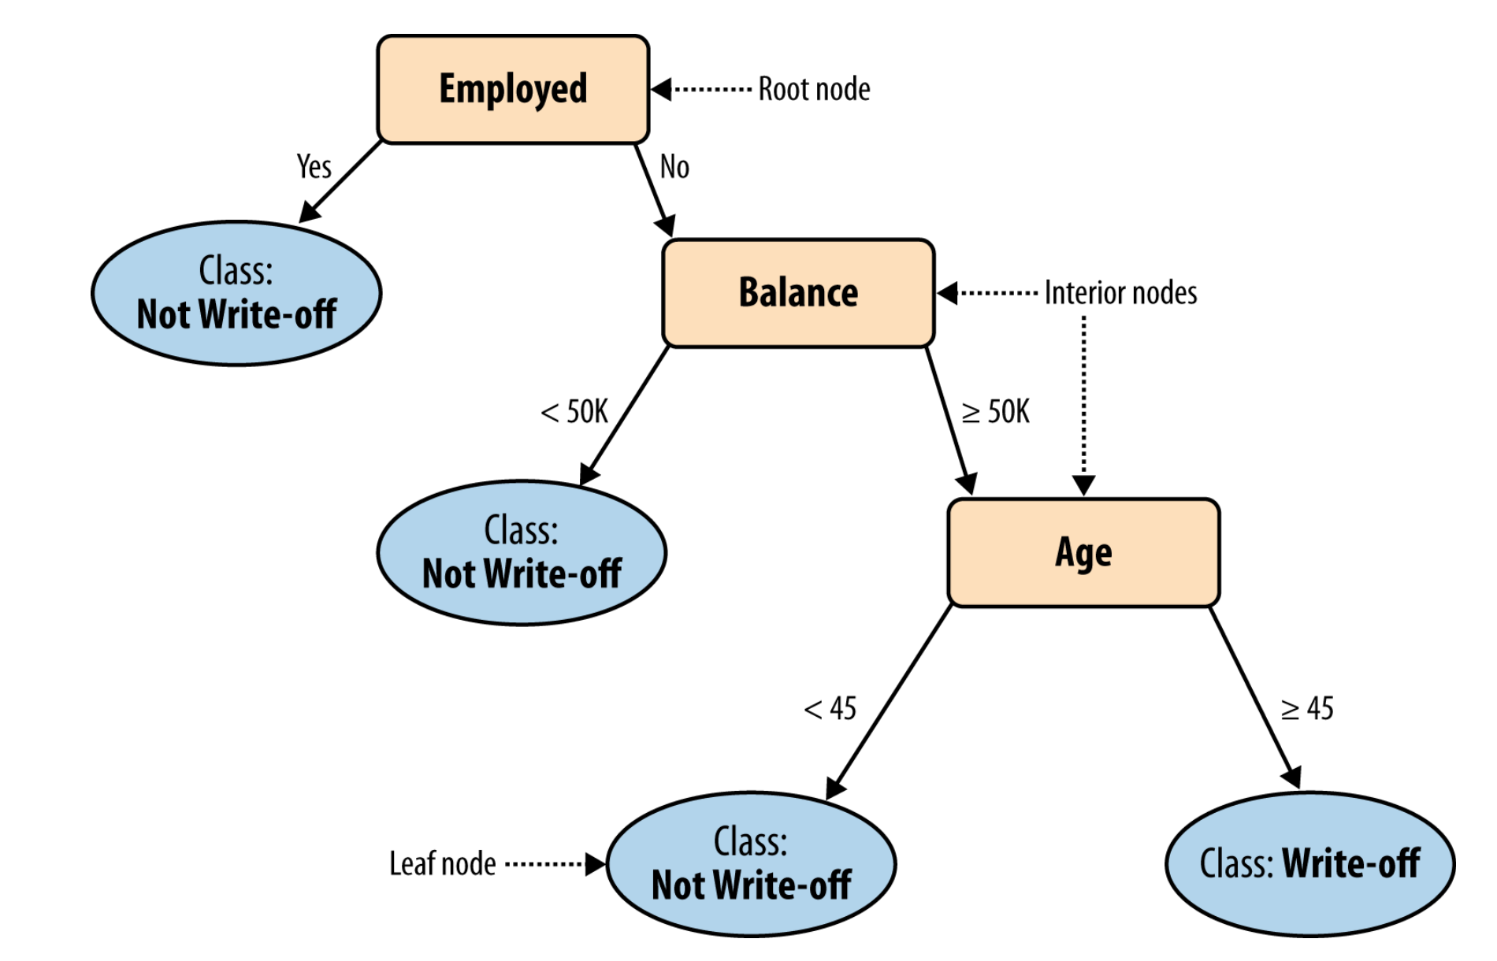
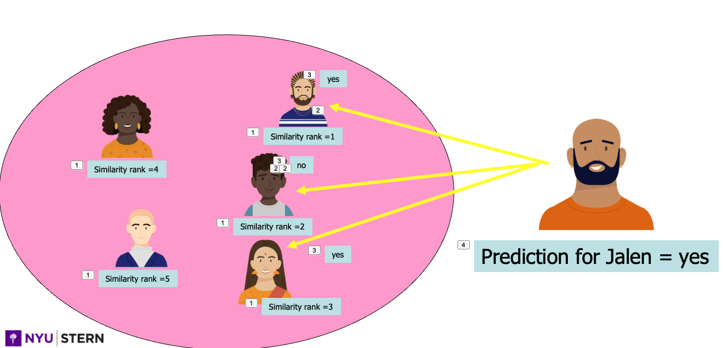
kNN vs. trees for classification
Both easy to interpret, work well..
No interpretable rules about how features impact target
Similar cases (or small perterbations in input) could have big impact on predictions
Notes:
What are the pros/cons
Trees: similarty

Slide 22
Geometric interpretation
Age
X
How would you classify these X values?
40
X
X
100K
Income
Notes:
K=1 vs 3 might be different…

Slide 23
How does a 1-nearest-neighbor classifier partition the space?
Age
Question: Which is more complex, higher or lower k??
40
100K
Income

Slide 24
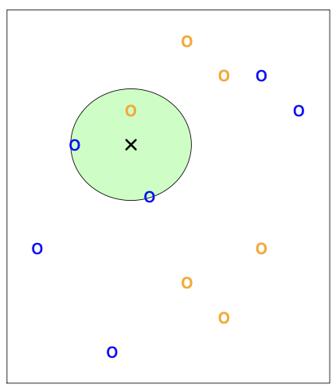
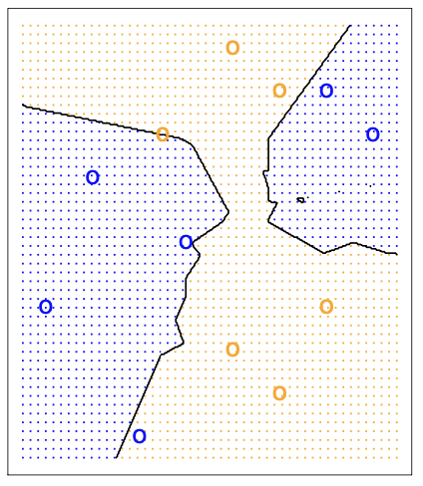
kNN – Decision Boundaries
k=3 nearest neighbors
Decision boundary for k=3

Slide 25
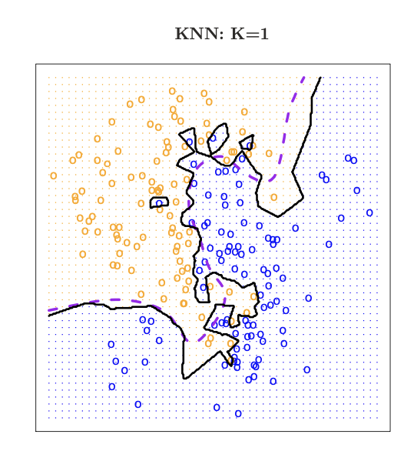
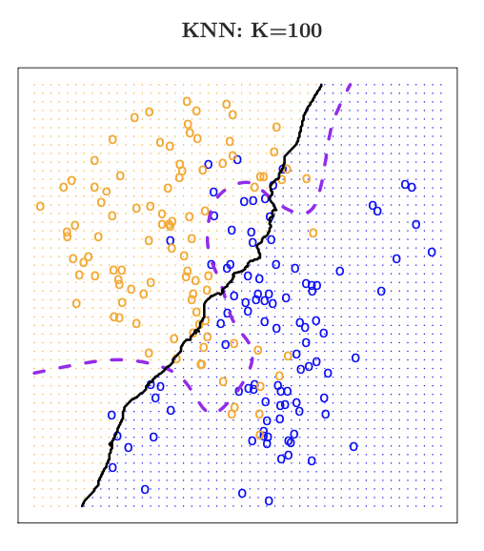
kNN and Complexity
Dashed line is the “Bayes Rate” – the optimal answer based on knowing how the data was simulated
K is a complexity parameter
Small k tends to overfit the data
ISL Chap 2.2

Slide 26
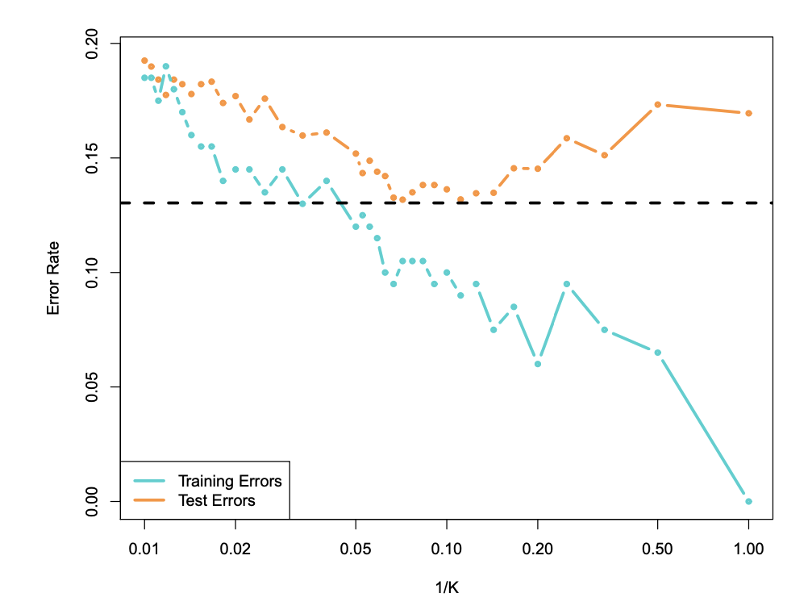
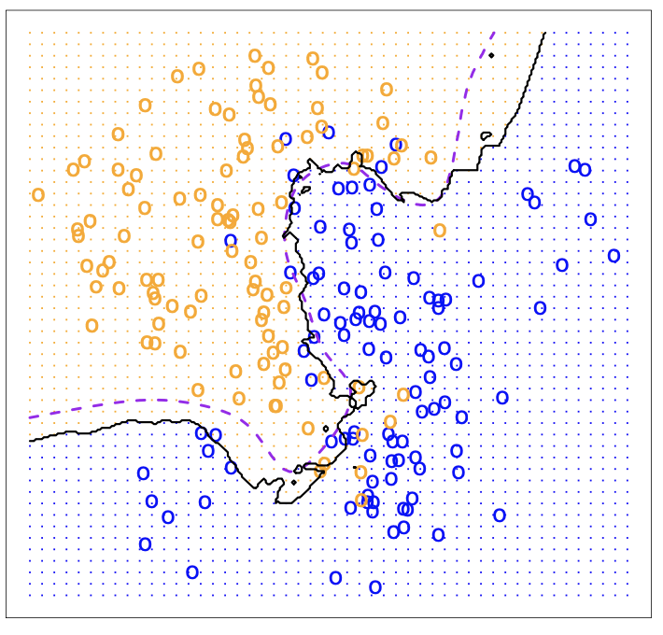
Optimizing k though cross-validation
k=10
Because high values of k correspond to low complexity, we use 1/k as the X-axis

Slide 27
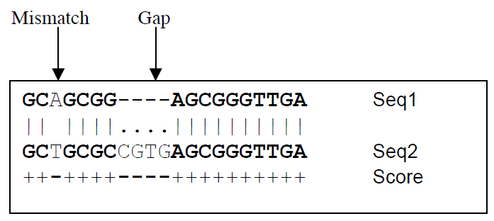
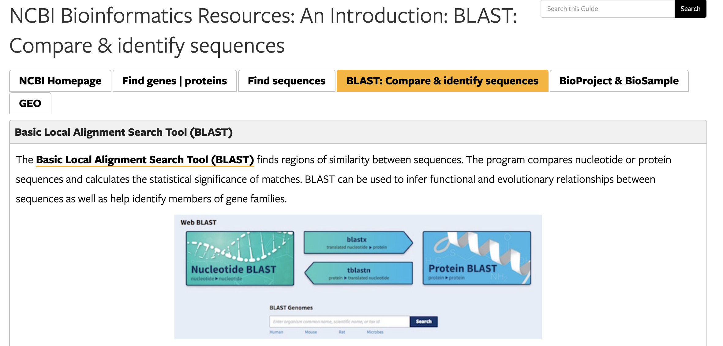
kNN
Real-world application : genetics
Newly discovered genes get classified based on their nearest neighbors
Specialized distance metrics because some areas of the sequence are known to be more important

Slide 28
kNN as Regression model
kNN also works as a regression model
To get a prediction – use the average of the k nearest neighbors…
Finding the right k via cross-validation : use RMSE instead of error rate…
sklearn.kNeighborsRegressor

Slide 29
Unsupervised Learning - Clustering

Slide 30
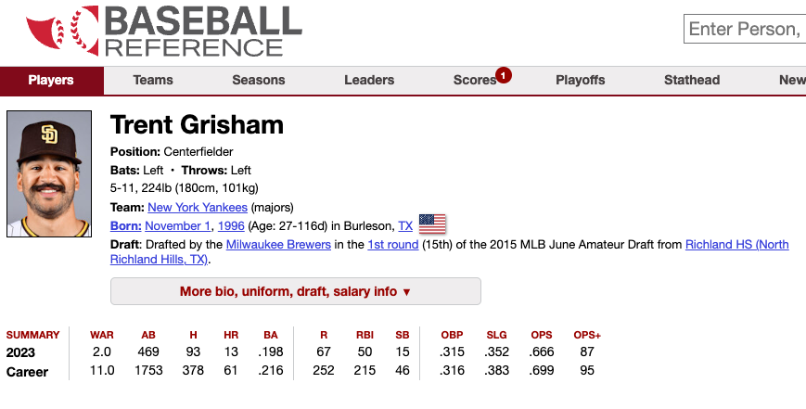
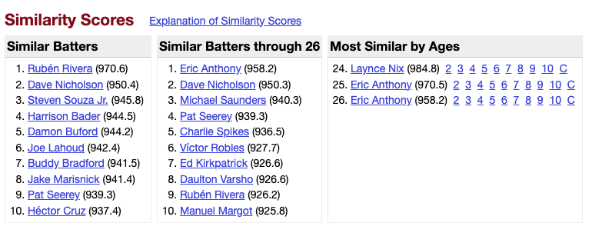
From Supervised to Unsupervised
The same ideas using similarities and differences for the purpose of classification can also be applied to unsupervised learning
Sometimes you might just be interested in exploring similarities:
https://www.baseball-reference.com/about/similarity.shtml

Slide 31
Clustering
Instead of looking up each case individually, what if we could automatically find interesting groupings of my data?
This can be useful in several business contexts;
Customer segmentation : group customers by purchase histories, preferences and demographics to better give them offers
Recommendation algorithms : find similar groups of customers and recommend similar shows to them based on known preferences
Early identification of fraud or poor risk customers : certain behaviors might tag a transaction or customer as similar behavior to other bad actors.
Clustering of documents for information retrieval, or legal review…
Clustering can be painful and more of an art than a science
BUT, can be a “cheap” way of doing kNN also
Notes:
By defining pre-set groups, no need to calculate all of the distances from everybody to everybody else.
Also, can combine with distances for a new customer.

Slide 32
Clustering
Question: How do I find (distinct) groupings of similar things?
“things” are objects with many features (multidimensional)
Key notions:
Define a similarity/distance metric between objects
Let the algorithm define clusters so the distance to things in a cluster are smaller than the distance between clusters
Two basic types of clustering:
Centroid based (a.k.a. Partitional)
Hierarchical
Note: Clustering assumes that each observation falls into one (and only one!) cluster
Notes:
Note: clustering assumes each point falls into

Slide 33
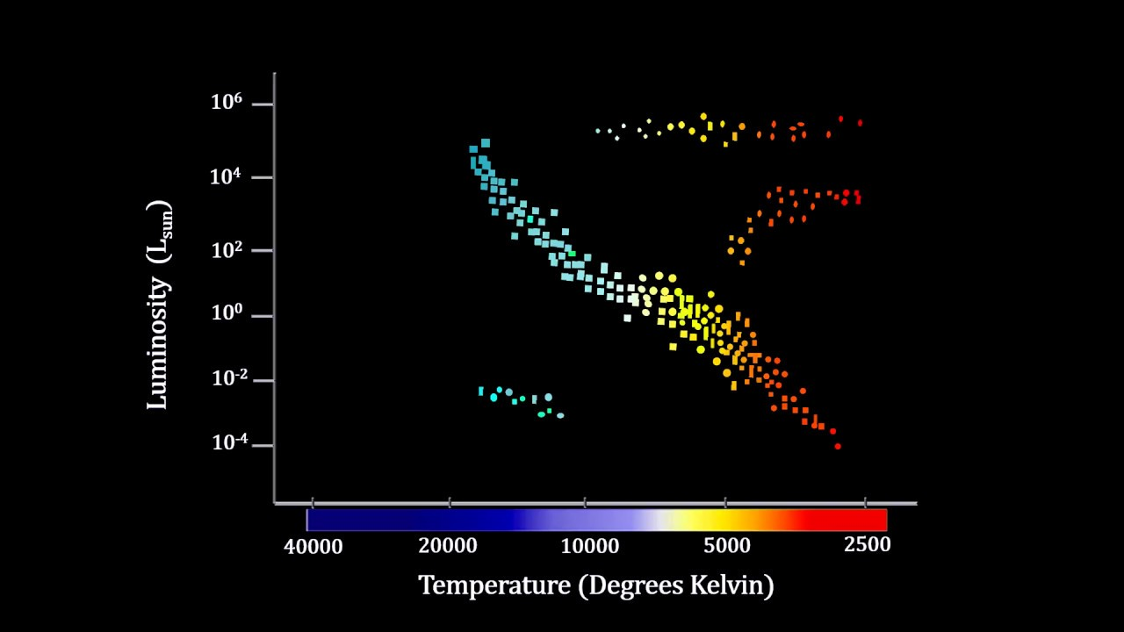
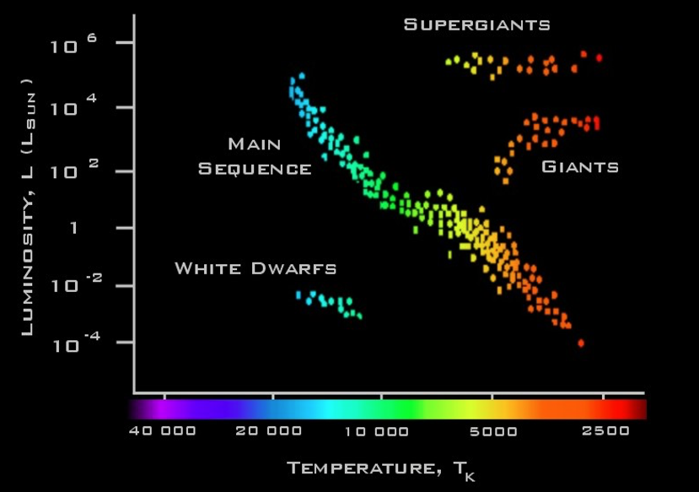
Clustering
Data sometimes (but definitely not always!) data falls into well defined clusters:
Hertzsprung – Russel diagram of stars
In this way, clustering can be a useful way of explaining data

Slide 34
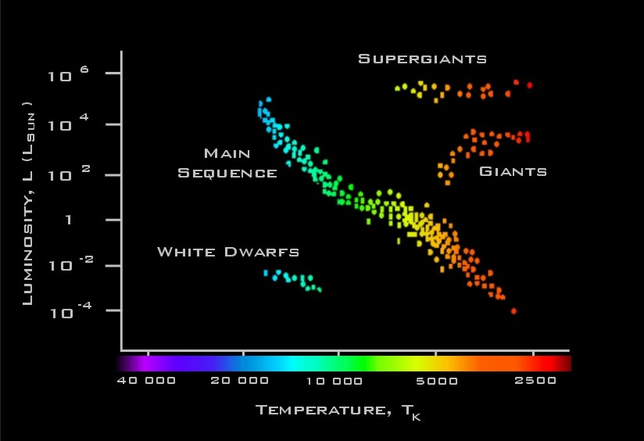
Clustering: Main idea
Ideally : create clusters of data items to achieve:
Maximum similarity between items within a cluster
Maximum dissimilarity between characteristics of different clusters
Intra-cluster distances are minimized
Inter-cluster distances are maximized

Slide 35
Clustering
Note: this is an idealized case, and only two dimensions, BUT
All data can be clustered, but clusters don’t always make sense!
Distance metric is important and can have a lot of impact on the clusters found
Result of clustering algorithm
Each data point is assigned to one of the k clusters
For some algorithms, you get a probability of cluster belonging – assign to highest probability cluster
Usage:
New points can get assigned in various ways
Distance to cluster center
Cluster of closest point (or k points!)
Use cluster instead of original features (dimensionality reduction)

Slide 36
Clusters: k-means
One popular type of clustering is called “k-means clustering”
Again with the k!
k-means clustering:
Requires you to pick the number of clusters when you start – k!
Start with some guess as to the cluster centers
Iterate between
Classifying each point in one of the clusters
Recalculating cluster centers

Slide 37
Center-based clustering
Example: “K-means” algorithm
iterative nearest-neighbor clustering
find “best” K cluster centers
Notes:
dimensions: horizontal frequency of visit
vertical amount spent
coming out: tenure with company

Slide 38
K-Means
Predetermined
number of clusters
Start with seed centroids – random??
Seeds

Slide 39
Assign Instances to Clusters
Every point gets assigned to a cluster based on which centroid it is closest to

Slide 40
Find New Centroids
Calcuate the new centroids of the clusters

Slide 41
New Clusters
Repeat !!

Slide 42
How to pick k?
When you start with a data set you have no idea how many clusters there are!
Why cant we just select k via cross-validation???
There are principled ways to try and figure it out.
Lets look at a case where it should be easy…
Notes:
No cross-validation because there is no metric for success!!!

Slide 43
K-means Clustering
kmeans_Clustering. ipynb ipynb

Slide 44
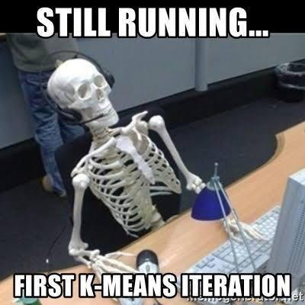
Discussion: k-means clustering
Data naturally does not cluster!!!!
But the algorithm will always find clusters….
Caveat emptor….
Applicable to fairly large data sets
Sensitive to initial centers
Multiple initial run (n_init) in sklearn implementation helps
Converges to a local optimum
Can run multiple times and get very different results
Specifying the number of centers very subjective
sklearn.cluster.KMeans
Notes:
S in py

Slide 45
Clustering: Hierarchical Clustering
Build a hierarchy of clusters from the bottom-up …
B
D
A
C
E
Start with n clusters, and progressively merge data until you have one cluster

Slide 46
Clustering: Hierarchical Clustering
A different philosophy on how to find clusters:
Generic Algorithm:
Compute all pairwise example-example similarities
Place each of n examples into a cluster of its own
Merge the two most similar clusters into one;
replace the two clusters by the new cluster
Repeat the above step until there are only k clusters left (note k could = 1).

Slide 47
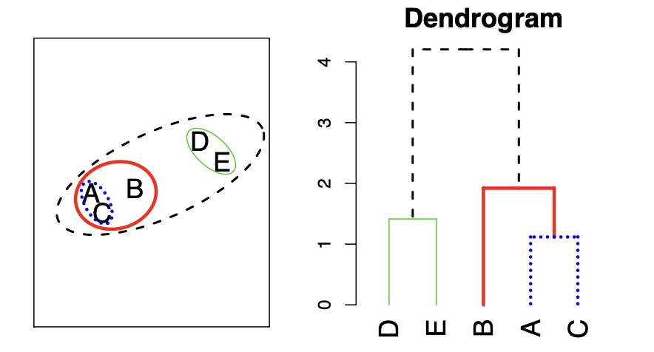
Dendrograms
Dendrograms are a visual representation of the hierarchical clustering process
Closest points get connected lower in the dendrogram

Slide 48
Dendrograms
Where you cut the dendrogram determines how many clusters you return:
This cut results in 2 clusters
This cut results in 6 clusters
You can partition your data into any number of clusters, from 1 to n

Slide 49
Make the Dendrogram!!
F
C
D
E
B
I
A
G
H

Slide 50
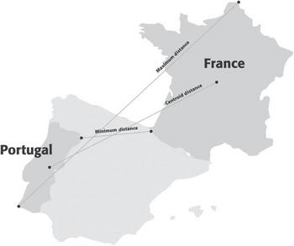
Hierarchical Clustering
Requires another metric: distance between clusters:
Maximum (complete linkage)
Distance between clusters is the maximum distance between two points
Minimum (single linkage)
Distance between clusters is the minimum distance between two points
Average
Distance is the average of all distances
Centroid
Distance is the distance between the centroids
Tends to have low stability
Results depend on linkage, on distance, normalization, and can be impacted by outliers
Shmueli Ch 15

Slide 51
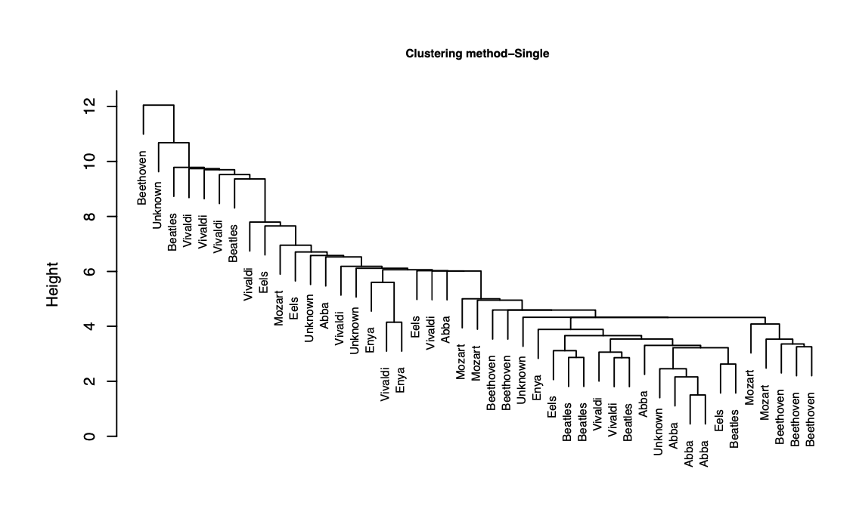
Hierarchical clustering
Clustering can be frustrating to try and fit
Sometimes

Slide 52
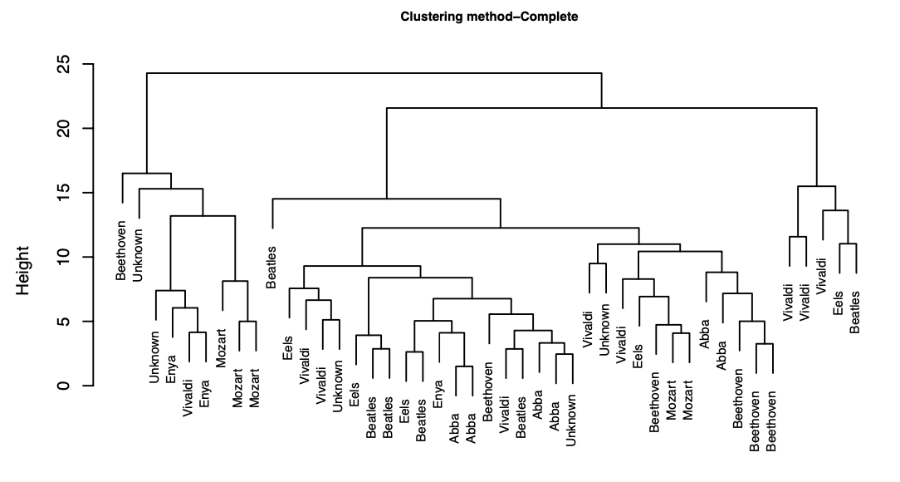

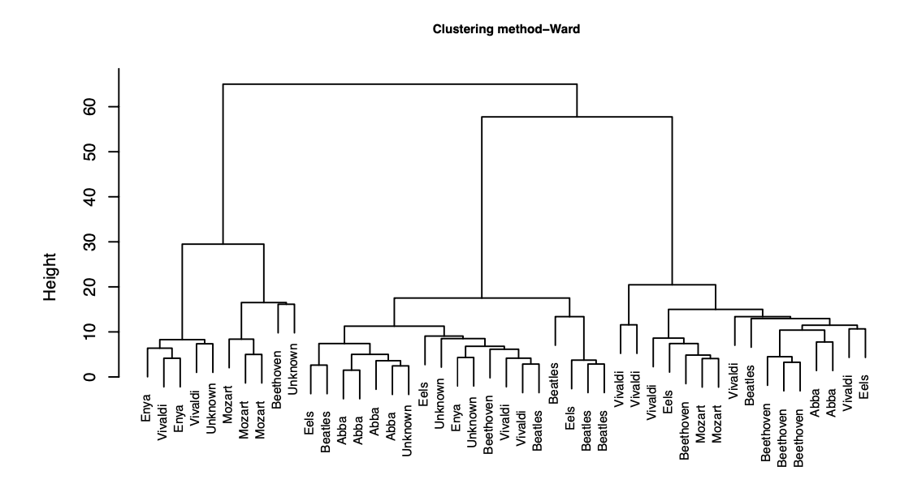
Music example
Ward’s method: a way of doing Hierarchical clustering – merging is decided based on increase in within-cluster variance
Notes:
More art than science!

Slide 53
Hierarchical Clustering
HierClust.ipynb

Slide 54
Clustering Beware
Very hard to evaluate clustering output! Consider the following:
Cluster interpretability – did you find anything interpretable?
Cluster stability – do your clusters change with different inputs?
Cluster separation – does there really seem to be a difference between the clusters in a meaningful way?
Number of clusters – did you end up with enough to be meaningful in a business sense?
Because there are so many different levers to pull, and so little way to evaluate it – remember Rick!
It can be mis-used…algorithms will always reveal clusters, even if there is no real clustering in the data
Use sparingly, especially if there is no expectation of actual clustering
Or just use as an exploratory measure to find interesting signal or to inspire other work.

Slide 55
Class Data
T9_ClassSimilarities.ipynb

Slide 56
Case Study – AT&T Cellular users

Slide 57
Intro
Study of AT&T mobile customers
Can we characterize their usage to learn about them?
Apply clustering algorithms to find user groups which share similar patterns of usage intensity over time.
All data is analyzed anonymously

Slide 58
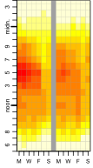
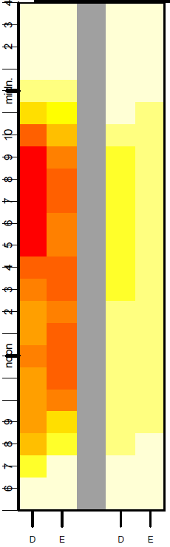
Data
Voice
SMS
Anonymized CDRs (Call Detail Records) collected over a 60 day period from 35 cell towers located within 5 miles of the center of Morristown.
152178 users have transactions in both months.
Aggregate voice and SMS usage separately into bins. Each bin represents a particular hour of the day and day of the week.
Aggregate daily bins by weekdays (M-F) and weekends (Sat/Sun), resulting in 24(hours)×2(weekday vs. weekend)×2(Voice vs. SMS)=96 bins.
Voice
SMS
August 11, 2011

Slide 59
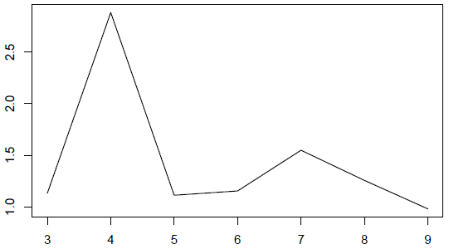
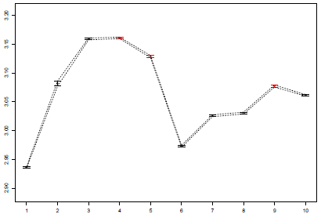
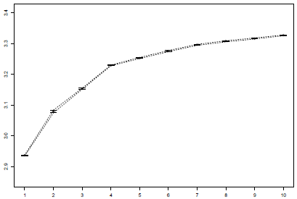
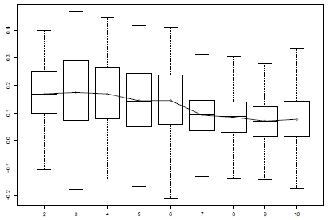
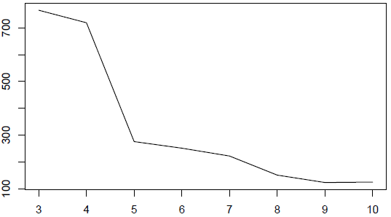
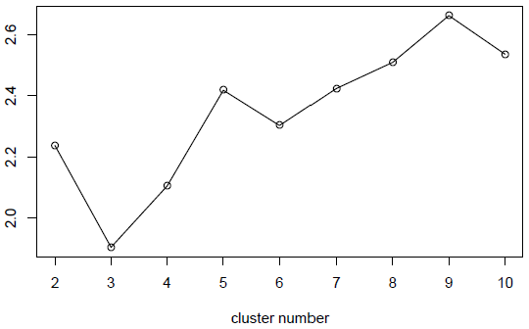
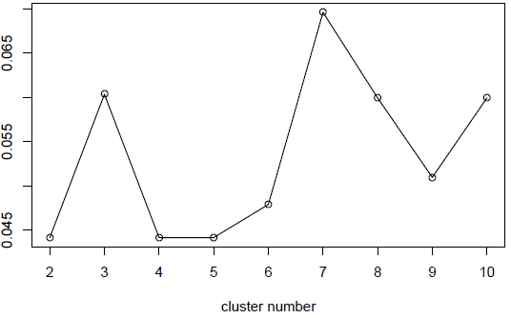
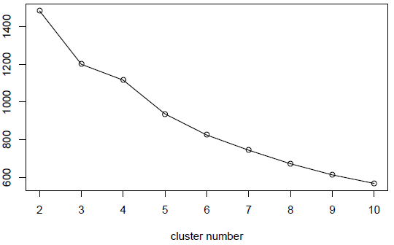

Finding the ”Correct” number of clusters
KL(4)
Weighted Gap(4)
These are all methods from published research papers on how to find the best number of clusters
Gap(7)
Silhouette(4)
Hartigan(5)
DB(3)
Dunn(7)
Calinski(4)
August 11, 2011
Notes:
We didn’t know what to choose..so we looked in the literature…

Slide 60
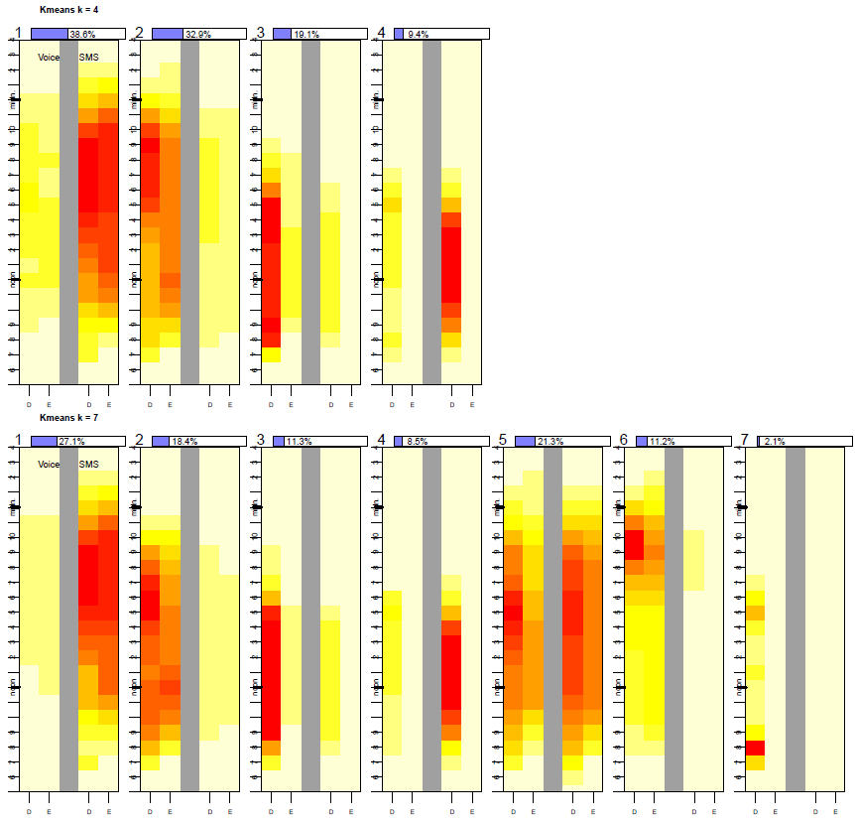
Determining the number of clusters K
Look at the centroids of the clusters. Do they make sense?
Go from k=4 to k=7. Do the new clusters add value?
November 6, 2024

Slide 61
Evaluation of Clustering Algorithms
Even though there is no ‘response’ – we can still do X-validation!
Two fold cross validation:
Randomly sample 50% of the data to be used as training set for clustering.
For each user in the test set, we want to see if the cluster they are assigned to in December matches the cluster they are assigned to in January.
Each vector is assigned to clusters according to their proximity to cluster centers derived on the clustering of the training set.
Training Set (50%) Clusters: C1 C2 C3 C4 C5 C6 C7
A user in the Test Set (50%): Dec usage Jan usage
Agreement measure:
Agreement Counts |  | Dec
 |  | Yes | No
Jan | YES | 20 | 5 | 25
 | NO | 10 | 15 | 25
 |  | 30 | 20 | 50
Can use this method to compare different linkages, or different k
But only if you assume that you think customer behavior doesn’t change
August 11, 2011
Notes:
There are 8 professional Services Practice Areas:
1. Education and Training
2. Enterprise Application Solutions
3. Enterprise Resource Planning and Management
4. Information Assurance
5. Knowledge Management
6. Modeling and Simulation
7. Network Transformation and Management
8. Program Management

Slide 62
Summary – Topic 8
Similarities
Many different ways to calculate similarities (and differences!) between data points
K-nearest neighbors
A useful method for classification that doesn’t involve fitting a model
Clustering
Unsupervised learning method to find groups in data
K-means
Iterative clustering algorithm that finds groups using distances and a given k
Hierarchical clustering
Clustering algorithm that builds a nested sequence of clusters, allowing one to choose any possible k

